Slide 1


Steakhouses in Phloenchit, Bangkok, Thailand

Slide 2
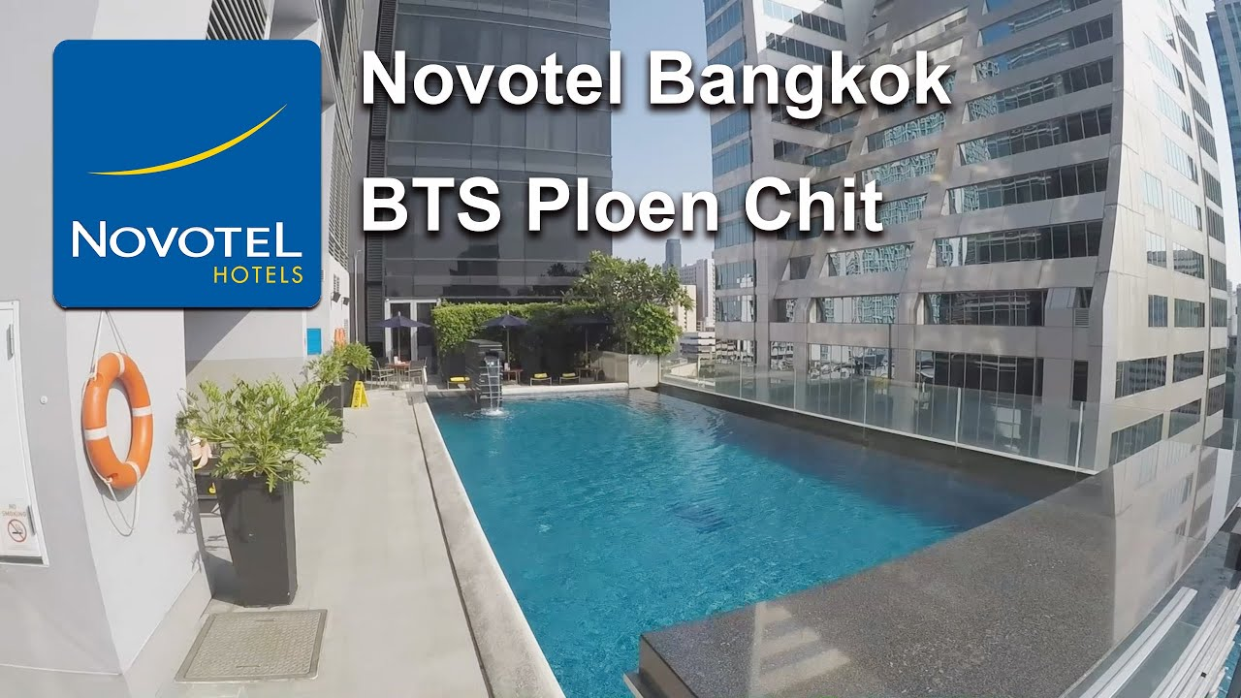

Slide 3
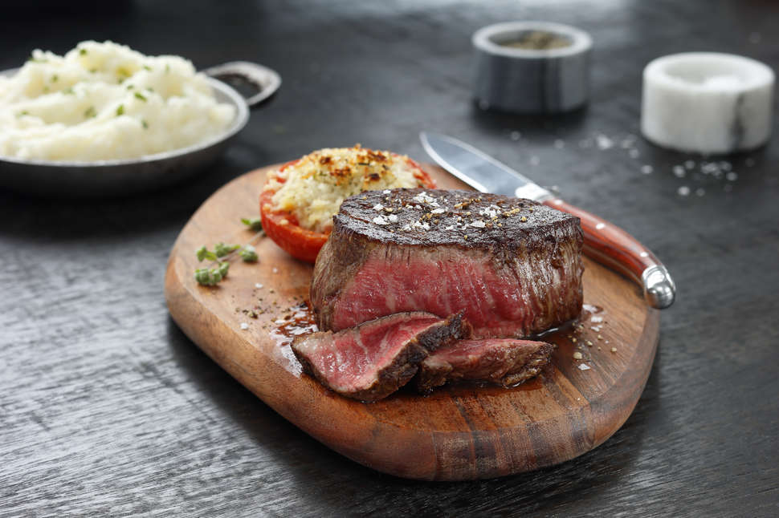
Objectives
Available steakhouses
Near the hotel (<1,000 m)
Visualization

Slide 4

Methodology
Acquiring Data

Slide 5
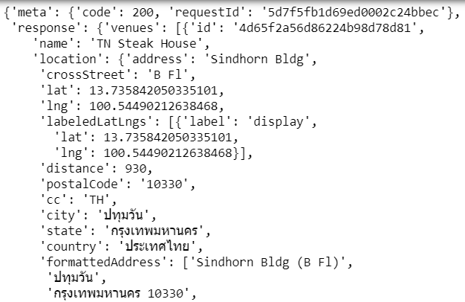
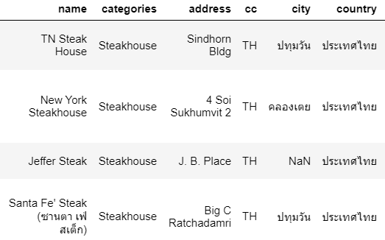
Methodology
Transforming and cleaning Data

Slide 6


Methodology
Analysis

Slide 7
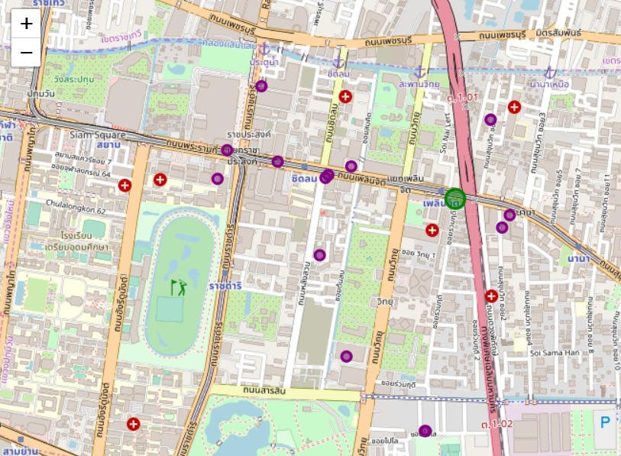
Result

Slide 8
Conclusion
Helpful visualization
Can add filters to help with ease of navigation
Can add more user interface
Can add more information and labels

